Slide 1

Module 7: Building Siebel SDE and SIL Mappings
0/5
Analytics: Data Warehouse Developer (Siebel 7.7)
Notes:
Time: Lecture: 60 minutes; labs: ~ 1 hour, 30 minutes
Intent: To learn the process for building Siebel SDE and SIL mappings in Informatica Designer to populate the Siebel Relationship Management Warehouse.
Flow: Connect to Informatica repository; explore repository folders; add sources; add targets; add mappings; modify mappings; validate mappings; save repository.
Key Terms:
Source Dependent Extract (SDE) mapping
Source Independent Load (SIL) mapping
7

Slide 2
Module Objectives
After completing this module you will be able to:
  Describe the process for building Siebel Source Dependent Extract (SDE) and Source Independent Load (SIL) ETL mappings using Informatica Designer tools
  Build Siebel SDE and SIL mappings using Informatica Designer tools
Why you need to know:
  You need to know how to build Siebel SDE and SIL mappings to populate the Siebel Relationship Management Warehouse
Notes:
Each objective and “why you need to know” should be stated aloud.

Slide 3
Process Flow: Building ETL Mappings
0/7
Connect to repository
Add sources
Add targets
Add mappings
Modify mappings
Validate mappings
Save repository
Notes:
This is a structuring slide. Do not teach the steps or concepts here because the following slides cover them in detail.
7

Slide 4
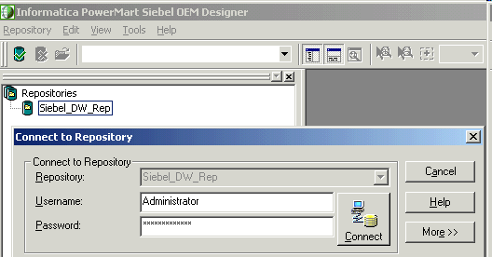
1. Connect to Repository
1/7
Select Start > Programs > Informatica PowerMart 6.2.1 OEM for Siebel > Designer
Repository contains:
  SDE and SIL folders
  Custom folder
  Custom mapping templates
  Existing mappings
Double-click repository
Enter username and password and click Connect
Notes:
This slide identifies the steps to connect to a repository in Informatica Designer. Callouts provide details.
This slide also identifies four components of the repository. Each of these is presented in the slides that follow.

Slide 5
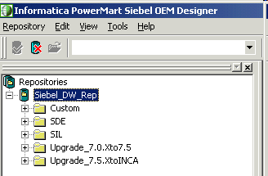
SDE and SIL Folders
1/7
Contain Siebel Informatica repository objects
Do not modify objects in the SDE and SIL folders unless it is explicitly mentioned
  Folders may be overwritten in future upgrades
  Carefully record any custom work done in SDE and SIL folders so that customizations can be reapplied during repository upgrades
Notes:
SDE and SIL folders ship with the Siebel Relationship Management Warehouse and contain the standard Siebel Informatica repository objects.
Emphasize that objects in these folders should not be modified unless explicitly mentioned in Siebel documentation. Any modifications to this folder may be overwritten in future upgrades, so if modifications are made, they must be carefully tracked.
The graphic identifies the location of the SDE and SIL folders in Informatica Designer.
7

Slide 6
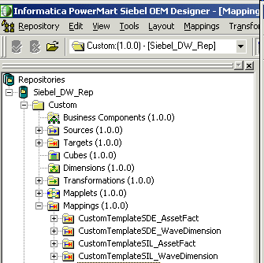
Custom Folder
1/7
Used to modify existing objects copied from SDE and SIL Siebel repository folders
Contains custom mapping templates
Custom mapping templates
Notes:
The Custom folder also ships with the Siebel Relationship Management Warehouse. It is used to create new custom repository objects and mappings, and to modify existing objects copied from the SDE and SIL folders.
Emphasize that Custom contains prebuilt custom mappings, explained on the next slide.
The graphic identifies the location of the Custom folder in Informatica Designer.
In the labs, students develop mappings in the Custom folder.

Slide 7
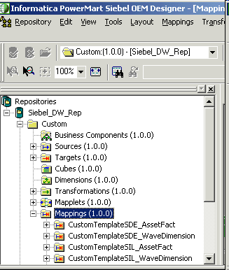
Custom Mapping Templates
1/7
Are used as a starting point to build new mappings
Drag and drop custom templates to Mappings folder and rename
Notes:
Custom mapping templates are shipped with the Siebel Relationship Management Warehouse and are used as a starting point to build custom mappings to extend or customize the SRMW.
New mappings are created by dragging the desired custom mapping template onto its parent Mappings folder and renaming the mapping. Students get practice doing this in the lab.
7

Slide 8
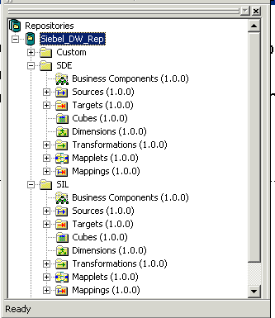
Existing Mappings
1/7
Can also be used as a starting point to build new mappings
Should be copied from SDE and SIL folders to the Custom folder before being modified
Notes:
You can also use existing mappings from the SDE and SIL folders as a starting point to create new mappings.
The process is similar to using custom mapping templates. Copy the desired mapping from its folder to Custom by dragging it to the Mappings folder in Custom. Informatica Designer prompts you to confirm the copy and rename the mapping.

Slide 9
2. Add Sources
2/7
Use the following steps to add sources:
  Open Source Analyzer
  Copy existing sources
  Import sources
  Create ODBC data sources
  Verify sources
Notes:
This is a structuring slide for adding sources. Each step is covered in detail in a subsequent slide.
7

Slide 10
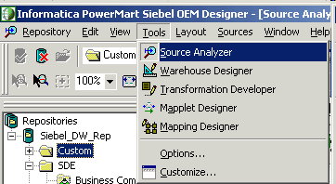
A. Open Source Analyzer
2/7
Select the Custom folder and select Tools > Source Analyzer
Notes:
The Source Analyzer is used to import or create source definitions for mappings. This slide identifies the steps to open the Source Analyzer in Informatica Designer.

Slide 11
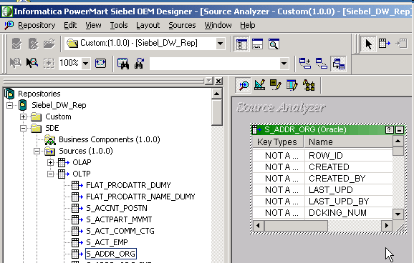
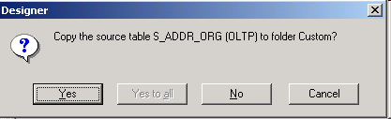
B. Copy Existing Sources
2/7
Copy existing sources from SDE and SIL folders to the Custom folder
Drag and drop sources into Source Analyzer window
Confirm copy to Custom folder
Notes:
This slide identifies the steps to copy existing sources from SDE and SIL folders to the Custom folder. Callouts provide details.
Existing sources must be copied to the Custom folder to use them when building new mappings, because new mappings must be built in the Custom folder, not the SDE and SIL folders. Students get practice copying existing sources and importing new sources in the labs.
7

Slide 12
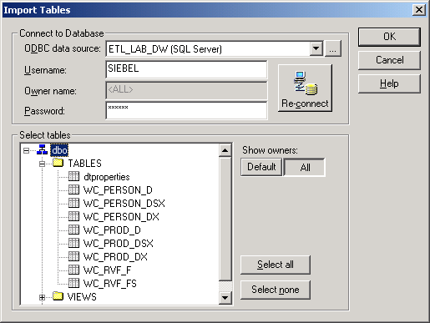
C. Import Sources
2/7
Select Sources > Import from Database
Select ODBC data source
Provide username and password
Click OK to add sources
Click Show owners
Select desired tables
Notes:
Sources needed to build mappings also can be imported from external data sources into the Custom folder. Connections to external data sources are made via ODBC data sources. Callouts provide the details of the steps. Students get practice importing sources in the labs.

Slide 13
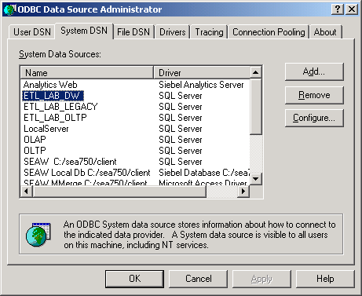
D. Create Source ODBC Data Source
2/7
If necessary, click the browse button to open ODBC Data Source Administrator to create a new ODBC data source
Notes:
As stated in the previous slide, connections to external data sources are via ODBC. If an ODBC data source connection does not exist for the desired external data source, it is possible to create new ODBC data source connections when importing sources by opening the ODBC Data Source Administrator through Informatica Designer. Informatica Designer provides a shortcut to the ODBC Data Source Administrator tool.
7

Slide 14
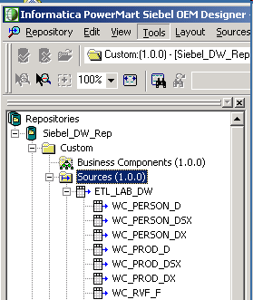
E. Verify Sources
2/7
Select Custom > Sources and verify that source appears and contains the expected tables
Notes:
After copying or importing sources, use the Navigator window to make a visual verification that sources appear and contain the copied or imported tables.

Slide 15
3. Add Targets
3/7
Use the following steps to add targets:
  Open Warehouse Designer
  Copy existing targets
  Import targets
  Create ODBC data sources
  Verify targets
Notes:
This is a structuring slide for adding targets. Each step is covered in detail in a subsequent slide.
7

Slide 16
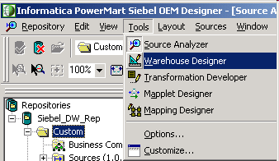
A. Open Warehouse Designer
3/7
Select the Custom folder and select Tools > Warehouse Designer
Notes:
The Warehouse Designer is used to import or create target definitions for mappings. This slide identifies the steps to open the Warehouse Designer in Informatica Designer.

Slide 17
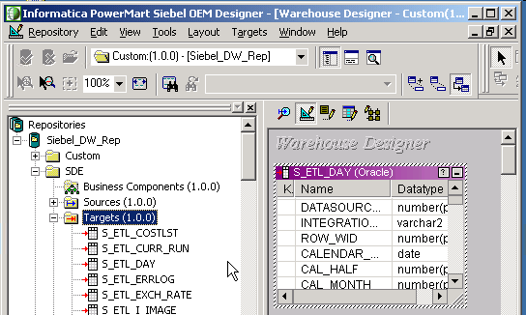

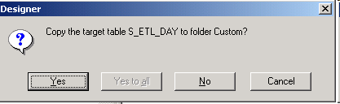
B. Copy Existing Targets
3/7
Copy existing targets from SDE or SIL folders to the Custom folder
Drag and drop targets into the Warehouse Designer window
Confirm copy to the Custom folder
Notes:
This slide identifies the steps to copy existing targets from SDE and SIL folders to the Custom folder. Callouts provide details.
Similar to sources, existing targets must be copied to the Custom folder to use them when building new mappings or can be imported from existing data sources, which is covered in next slide. Students get practice copying existing targets as well as importing new targets in the labs.
7

Slide 18
C. Import Targets
3/7
Select Targets > Import from Database
Select ODBC data source
Provide username and password
Click OK to add targets
Click Show owners
Select desired tables
Notes:
Targets needed to build mappings also can be imported from external data sources into the Custom folder. Connections to external data sources are via ODBC data source names. Callouts provide details. Students get practice importing targets in the labs.

Slide 19
D. Create Target ODBC Data Source
3/7
If necessary, click the browse button to open ODBC Data Source Administrator to create a new ODBC data source
Notes:
As stated in the previous slide, connections to external data sources are via ODBC. If an ODBC data source connection does not exist for the desired external data source, it is possible to create new ODBC data source connections when importing targets by opening the ODBC Data Source Administrator through Informatica Designer.
7

Slide 20
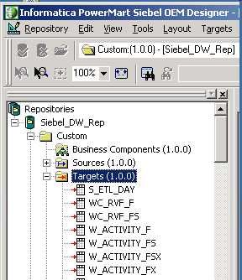
E. Verify Targets
3/7
Select Custom > Targets and verify that the targets appear
Notes:
After copying or importing targets, use the Navigator to make a visual verification that targets appear and contain the expected copied and imported tables.

Slide 21
4. Add Mappings
4/7
Use the following steps to add mappings
  Open Mapping Designer
  Copy custom mapping template
  Add mapping to Mapping Designer
Notes:
This is a structuring slide for adding mappings. Each step is covered in detail in a subsequent slide.
7

Slide 22
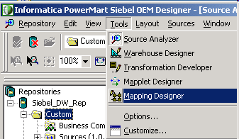
A. Open Mapping Designer
4/7
Select the Custom folder and select Tools > Mapping Designer
Notes:
The Mapping Designer is used to create and modify mappings. This slide identifies the steps to open the Mapping Designer in Informatica Designer.

Slide 23
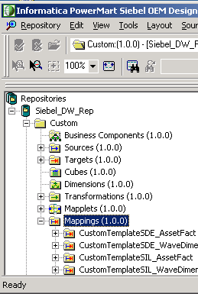
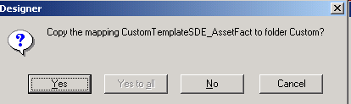
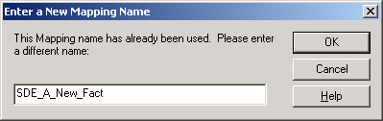
B. Copy Custom Mapping Template
4/7
Copy custom mapping template and rename
Drag and drop custom template to Mappings folder
Copy to Custom folder
Enter new name for mapping
Notes:
Copy the desired mapping by dragging it to the Mappings folder in the Custom folder. Informatica Designer prompts you to confirm the copy and rename the mapping.
7

Slide 24
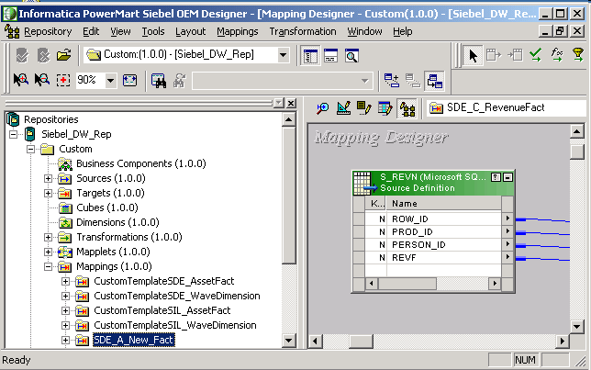
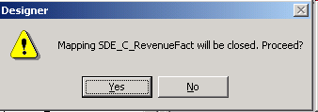
C. Add Mapping to Mapping Designer
4/7
Drag new mapping into Mapping Designer to begin modifying
Click Yes if prompted to close existing mapping
Notes:
Once the mapping is added to the repository, drag the mapping from the Navigator into the Mapping Designer window to modify it. You are prompted to close the existing mapping if another mapping is already displayed in the Mapping Designer.

Slide 25
5. Modify Mappings
5/7
Use the following steps to modify mappings
  Add source definitions
  Rename transformations
  Edit transformation ports
  Edit transformation SQL
  Edit transformation expressions
  Add target definition
  Link mapping components
Notes:
This is a structuring slide for modifying mappings. Each step is covered in detail in a subsequent slide.
7

Slide 26
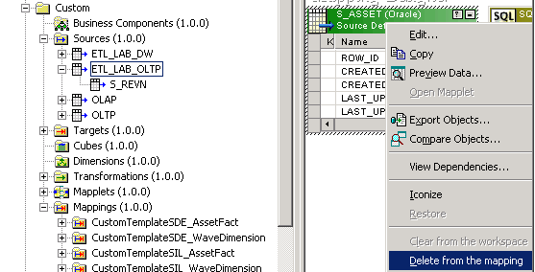
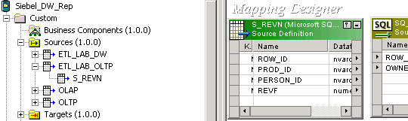
A. Add Source Definitions
5/7
Add source to mapping in Mapping Designer to create source definition
Delete existing source definition from mapping
Drag and drop source to add new source definition to mapping
Notes:
Drag sources from repository folders in the Navigator into the Mapping Designer to create source definitions in mappings.
In some cases, when using custom mapping templates or existing mappings, it is necessary to first delete the existing source definition in the mapping.
Students get practice deleting and adding source definitions in mappings in the labs.

Slide 27
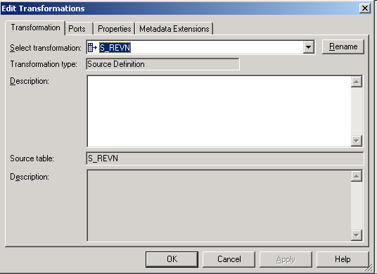
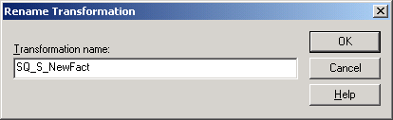
B. Rename Transformations
5/7
Double-click the transformation to open the Edit Transformations window
Click Rename button
Rename transformation
Notes:
Transformations may be renamed to conform to desired naming conventions for mappings.
Students get practice renaming transformations in the labs.
7

Slide 28
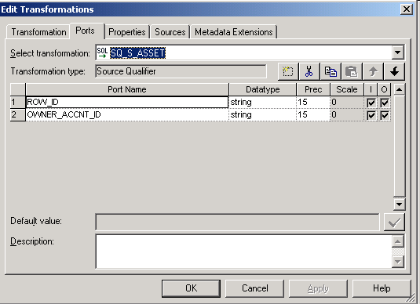
C. Edit Transformation Ports
5/7
Click the Ports tab in the Edit Transformations window to edit ports
Add new port
Delete port
Edit port names
Change port order
Notes:
Transformation ports can be modified as needed. Examples of modifications include:
Editing port name
Adding a new port
Deleting a port
Changing port order
Changing port datatype, precision, and scale
Modifying default value
Editing port description
Editing port expressions
Students get practice modifying transformation ports in the labs.

Slide 29
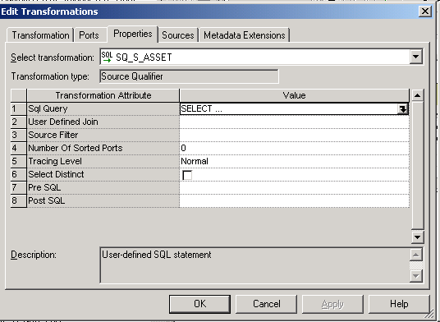
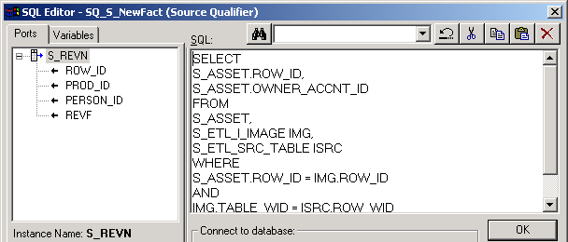
D. Edit Transformation SQL
5/7
Click the Properties tab in the Edit Transformations window to edit SQL
Click the down arrow button to open SQL Editor
Edit SQL
Notes:
For relational sources, the Informatica Server, when it runs a session, generates a query for each Source Qualifier transformation. The default query is a SELECT statement for each source column used in the mapping. Only columns that are connected to a column in another transformation are read by Informatica Server.
To view the default query in the Source Qualifier transformation, click SQL Query in the Properties tab. That opens the SQL Editor. Then click Generate SQL.
Columns in the Source Qualifier must be connected to another transformation or target before the default SQL can be generated.
Alter or override the default query in the Source Qualifier by changing the default settings of the transformation properties. Do not alter the list of selected ports or the order in which they appear in the query. The list of ports must exactly match the connected transformation output ports.
The SQL Query overrides all other settings in the Source Qualifier transformation. That means that if transformation properties are edited, the Source Qualifier includes these settings in the default query. However, if you enter a different SQL query, Informatica Server uses only the defined SQL statement, overriding any edits to transformation properties.
7

Slide 30
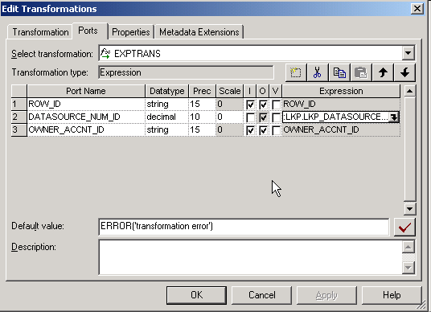
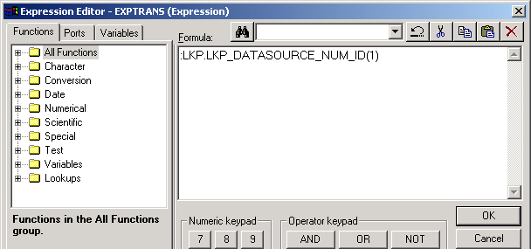
E. Edit Transformation Expressions
5/7
Click the Ports tab in the Edit Transformations window to edit expressions
Click the down arrow button to open Expression Editor
Edit expressions
Notes:
Use the Informatica transformation language to create a transformation expression that takes data from a port and changes it. During sessions, Informatica Server writes results to the target tables based on the expressions you define.
Examples:
Use the AVG function to calculate the average salary of your employees
Use the SUM function to calculate total sales for a specific branch
An expression can be as simple as a port, such as ORDERS, or a numeric literal, such as 1.
It is also possible to write complex expressions that include functions nested within functions, or combine ports using the transformation language operators.
In the example in this slide, the expression supplies an input value (1) for an unconnected lookup transformation named LKP_DATASOURCE_NUM_ID.
Avoid syntax errors when entering expressions by using the point and click method to select functions and ports from the left window.

Slide 31
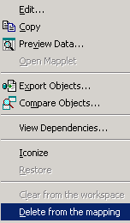
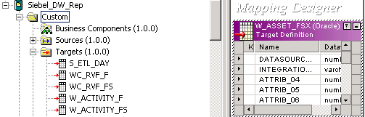
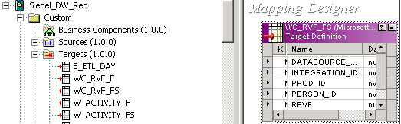
F. Add Target Definition
5/7
Add target to mapping in Mapping Designer to create target definition
Delete existing target definition from mapping
Drag and drop target to add new target definition to mapping
Notes:
Drag targets from repository folders in the Navigator into the Mapping Designer to create target definitions in mappings.
In some cases, when using custom mapping templates or existing mappings, first delete the existing target definition in the mapping.
Students get practice deleting and adding target definitions in mappings in the labs.
7

Slide 32
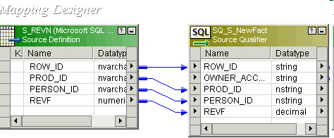
G. Link Mapping Components
5/7
Drag and drop ports to create links between mapping components
Links
Notes:
Create links between source definitions, transformations, and target definitions by dragging and dropping ports between the desired mapping components. A blue line indicates a link. To delete a link, click the blue line and select Edit > Delete, or press the Delete key.

Slide 33
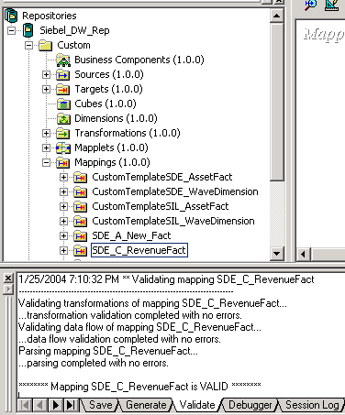
6. Validate Mappings
6/7
Select Mappings > Validate to validate mapping
Validation message appears in Output window
Notes:
Mappings must be configured correctly and then validated so the Informatica Server can read and execute the entire mapping without any errors. Mappings are marked invalid (with a red X) when errors are detected that prevents Informatica Server from executing the mapping successfully.
To determine if a mapping is valid, Informatica Designer checks the following:
Required ports are connected
All port connections are valid
All expressions parse successfully and are valid
The independent object definition matches the instance of the object definition in the mapping
Mappings are validated automatically when you save the repository. You also can validate mappings manually by selecting Mappings > Validate.
Validation results appear in the Output window. If a mapping is invalid, review the validation message in the Output window to determine the reason.
7

Slide 34
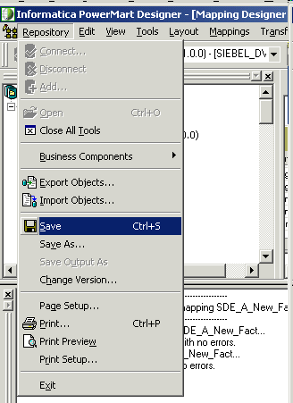
7. Save Repository
7/7
Select Repository > Save to save the repository if the mapping is valid
Notes:
When the mapping is completed and validated, save the repository.

Slide 35
Summary
This module showed you how to:
  Describe the process for building Siebel Source Dependent Extract (SDE) and Source Independent Load (SIL) ETL mappings using Informatica Designer tools
  Build Siebel SDE and SIL mappings using Informatica Designer tools
Notes:
This slide presents a summary of the topics covered in the module.
Review Questions:
Question: True or False. New mappings can only be built from custom mapping templates.
Answer: False. New mappings can also be built from existing mappings.
Question: True or False. All custom work should be done in the SDE folder.
Answer: False. Objects in this and the SIL folder should not be modified unless explicitly mentioned in Siebel documentation. Any modifications to this folder may be overwritten in future upgrades. All custom work should be done in the Custom folder
Question: True or False. Transformation ports cannot be edited.
Answer: False. Transformation ports can be modified as needed. Examples of modifications include:
Editing port name
Adding a new port
Deleting a port
Changing port order
Changing port datatype, precision, and scale
Modifying default value
Editing port description
Editing port expressions
7

Slide 36
Lab
In the lab you will:
  Build a Source Dependent Extract (SDE) mapping and a Source Independent Load (SIL) mapping using Informatica Designer tools
Notes:
Labs and Troubleshooting:
See lab instructions for lab details.
Labs 7-1 and 7-2 use the ETL_LAB_OLTP and ETL_LAB_DW databases.
The labs are very labor-intensive and prone to user error. Students validate mappings in these labs, but do not get an opportunity to verify the success of their labs until they run sessions for the mappings in the next module. Be prepared to help students troubleshoot the mappings in this module if there are validation errors.
If troubleshooting is unsuccessful, use the provided mapping solutions. The solution files are located on the site file share and solution CD provided to instructors. The mapping solution file names are noted below. Import mapping solutions into the repository in Informatica Designer by selecting Repository > Import Objects. If necessary, rename the mapping solutions when importing.
Files:
SDE_C_RevenueFact After Lab 7-1 - Mapping.XML, SIL_C_RevenueFact After Lab 7-2 - Mapping.XML

